Slide 1

Report from the ASO AC
https://aso.icann.org/

Slide 2
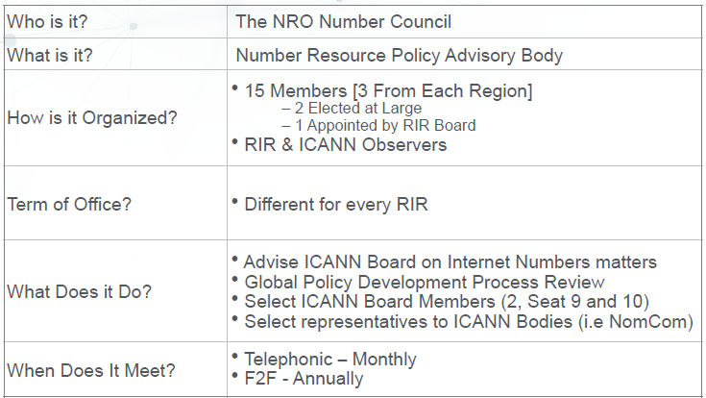
The ICANN ASO AC (Address Council)

Slide 3
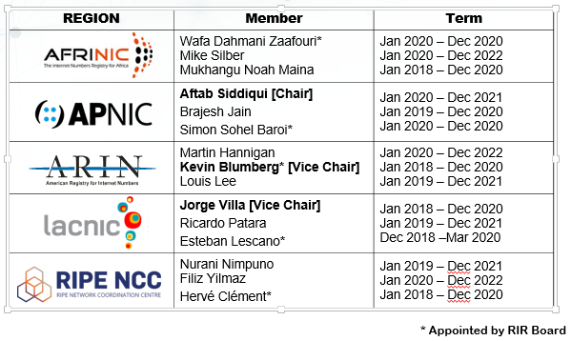
2020 Address Council Members
Last appointments
Esteban Lescano * (LACNIC)
April 2020 – March 2021
Jorge Villa (LACNIC)
Jan 2021 – Dec 2023
Saul Stein (AfriNIC)
Jan 2021 – Dec 2023
Nicole Chan * (APNIC)
Jan 2021 – Dec 2021
Shubham Saran (APNIC)
Jan 2021 – Dec 2022

Slide 4




2020 ASO AC Participation Record
REGION | Member | Attendance (out of 10)
 | Wafa Dahmani Zaafouri* Mike Silber Mukhangu Noah Maina | 5 7 9
 | Aftab Siddiqui [Chair] Brajesh Jain Simon Sohel Baroi* | 9 10 10
 | Martin Hannigan Kevin Blumberg* [Vice Chair] Louis Lee | 7 9 9
 | Jorge Villa [Vice Chair] Ricardo Patara Esteban Lescano* | 10 10 10
 | Nurani Nimpuno Filiz Yilmaz Hervé Clément* | 10 10 10

Slide 5
ASO AC Appointments
ASO AC Current Appointments
Maemura Akinori
  Seat 10 ICANN Board, 2019 - 2022 (from APNIC Region)
Ron da Silva
  Seat 9 ICANN Board, 2018 - 2021 (from ARIN Region)
Pankaj Chaturvedi
  ASO Representative in the ICANN NomCom – 2020 term
ASO AC 2020 Appointments
Seat 9 ICANN Board Start of selection process
  Term 2021 – 2024 (APNIC region not eligible)
ASO Representative to ICANN NomCom
  2021 Term – Pankaj Chaturvedi was re-appointed last July

Slide 6
ICANN Board Seat 9 Appointment
Nomination Phase: 15 September 2020 – 15 November 2020
Comment Phase: 21 December 2020 – 17 January 2021
ICANN Due Diligence for nominated candidates
Interview Phase: 25 January 2021 – 30 March 2021
Selection Phase (deliberation): 1 – 16 April 2021
Selection Phase (voting): 19 – 25 April 2021
Announcement of selected candidate: ~ 30 April 2021
https://aso.icann.org/icann-board/icann-board-elections/2021-icann-board-of-directors-seat-9-elections/

