Slide 1
Where Things Roam:
Uncovering Cellular IoT/M2M Connectivity
Andra Lutu* Byungjin Jun⁺ Alessandro Finamore*
Fabián E. Bustamante⁺ Diego Perino*
*Telefonica Research | ⁺Northwestern U.
Notes:
Hi everyone, Andra here – thank you for joining me in this session today!
Today I’m going to discuss how cellular IoT relies on mobile international roaming; and how “things” are mostly in roaming.

Slide 2
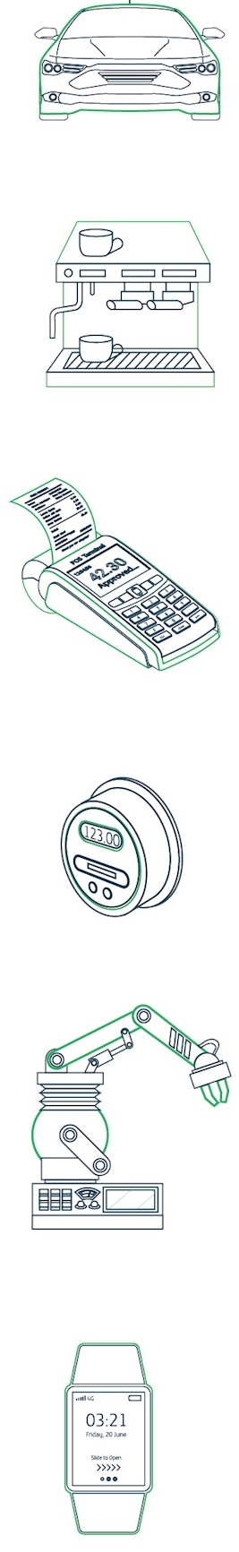
Why do “things” need to “roam”?
Any device that is not a smartphone people use day-to-day
Cellular IoT devices rely on mobile operators for seamless connectivity
Even if they don’t move, they connect over mobile networks ☺
..and sometimes they roam!
Connected cars
Connected coffee vending machines
Connected point of sale (PoS)
Smart meters (e.g., energy, gas)
Wearables (e.g., smart watches, e-readers)
IoT Verticals
Notes:
First, I wanted to clarify what we mean here by “things” and why they might need to “roam” (even if, in some cases they might not actually move).
So by things – we basically mean all that is not a smartphone someone uses on a day-by-day basis.
So we have many examples here for what we call “IoT verticals” (or use-cases) – connected cars, etc.
So all these are example of “cellular” IoT devices, which rely on mobile operators for their connectivity.
We’re not looking here at your Rumba vacuum cleaner or other small devices you connect to the WiFi network in your home.
Now Cellular IoT devices need seamless connectivity in any place where they might operate – for example, a connected car or your smart watch.
However, even if these devices don’t really move, they still connect over mobile networks, with embedded SIMs that their manufacturers buy from mobile network operators.
And these operators can be from anywhere, really, not just the country where the devices will operate.
So, in this sense, the “things” also roam!

Slide 3
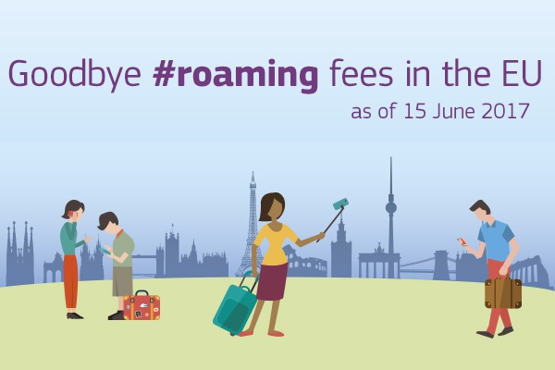
More mobile users, more roaming
Cellular networks support user mobility across operators with national or international roaming
Growth on international roaming driven by
  New regulation (e.g., Roam like at Home in the EU)
  Increased mobility of users and new technologies (e.g., VoLTE)
  Other industry trends (e.g., Internet of Things)
Notes:
But why the focus on roaming? And how did this once-niche service for people is becoming central to the cellular IoT market?
With more people moving around the globe (at least before the pandemic…) there was a lot of push for lowering the tariffs and remove the fear of bill shock on traveling abroad.
And with Roam like at home, that happened.
More people travelling meant more people roaming, and a more mature and robust infrastructure that allowed for some industry trends like cellular IoT to develop.

Slide 4
International Roaming
Operators contract with IPX providers
  IPX provider provides the roaming hub function
Operators/roaming partners don’t need bilateral contracts
  Instead pay a service charge to the roaming hub
Inter-operator tariff (IOT) between the Home MNO(HMNO) and Visited MNO (VMNO)
Inter-operator tariff
Service Charge
Service Charge
Roaming hub
IPX
Provider
IPX
Provider
Roaming hub
HMNO
VMNO
Inbound roamers
Outbound roamers
Notes:
But before I dive into thing roaming, let me just refresh some basic notions around how roaming works and how we can actually take our mobile phone and travel anywhere in the world.
Essentially, in order to be able to do that, your provider (the homen MNO) needs to establish interconnections with other operators around the globe (Visited MNOs).
And, for 4G, for example, they can do this easily using IP exchange providers.
Then, they have a commercial roaming agreement with multiple roaming partner across the world, where they agree how much to pay for their own users traveling to other visited networks.
Once this is completed, a network can receive inbound roamers from foreing networks or allow their users to become outbound roamers, and travel abroad and connect to other networks.

Slide 5
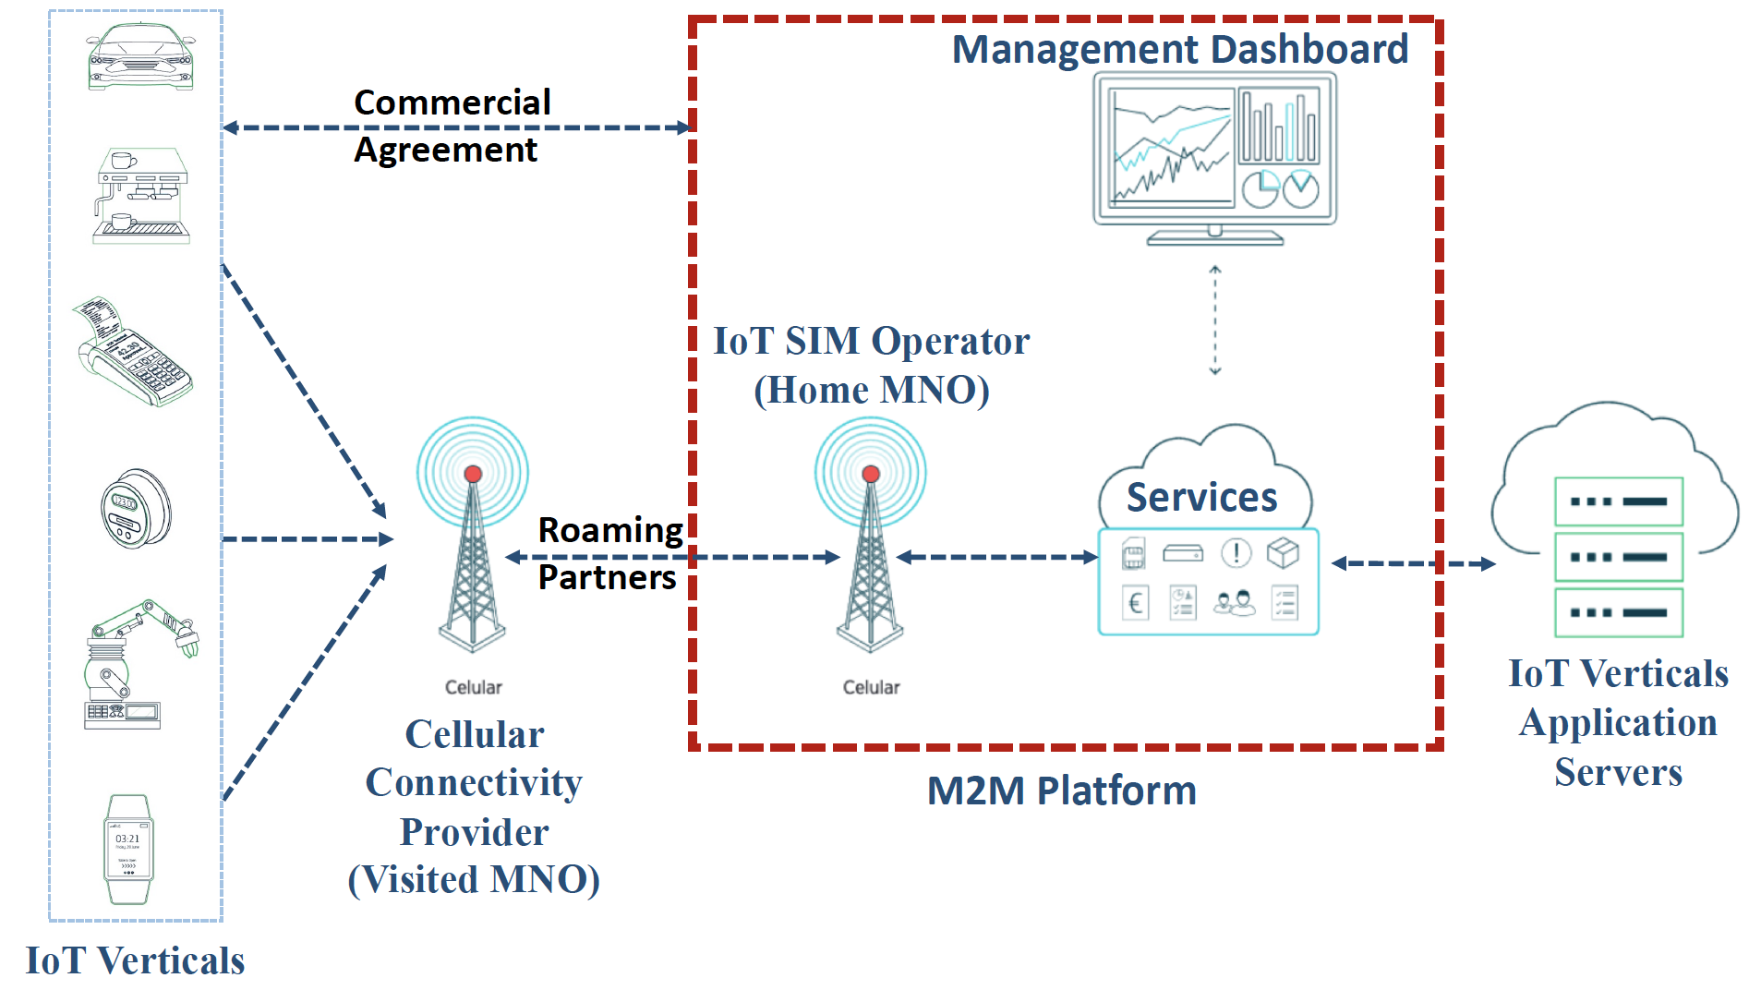
Things Roaming using an M2M platform
Service Charge
Inter-operator tariff
Service Charge
Roaming hub
IPX
Provider
IPX
Provider
Roaming hub
VMNO
HMNO
Notes:
Now, what we found is that infrastructure focused initially on people, can also allow things to connect much in the same way.
So M2M platforms emerged.
They work with one or several mobile operators who provide the SIM cards and connectivity to different IoT verticals.
The IoT devices can operate anywhere in the world, leveraging the roaming agreements of the operator supporting the M2M platform.
So this is where we see all the roaming ecosystem being leveraged.

Slide 6
Our dataset
An operational M2M platform
  100K 4G-enabled IoT devices
  11 days in November 2018
Visited MNO: Operational network in UK
  ~30M devices (Smartphones, feature phones, and IoT devices)
  22 days in April 2019
Notes:
What we aimed to do in our work is shed light into how pervasive these solutions are, from the point of view of an operation M2M platform and also from the point of view of a mobile network that allows IoT devices to connect to its network.
For the M2M platform we collect a sample of about 100k devices, whose whereabouts we checked for 11 days in November 2018
Then, for the view from the Mobile operator, we capture its entire population of devices for about 3 weeks in April last year, with the objective to understand which are inbound roaming IoT devices.

Slide 7
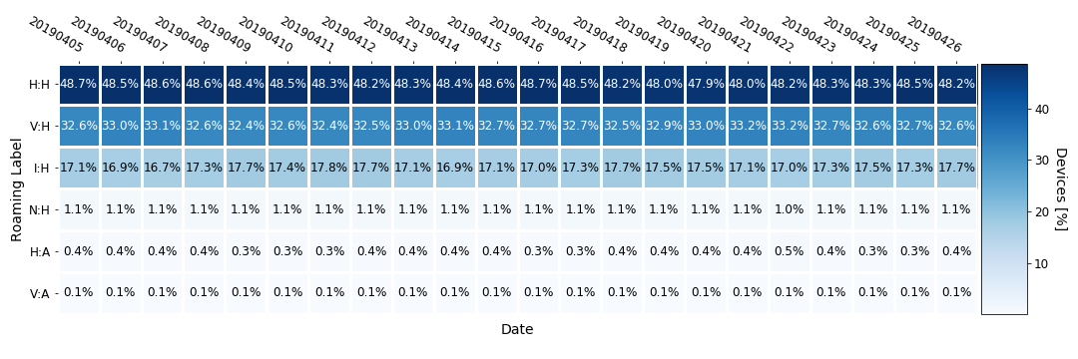
View from an Operational Mobile Network Operator
How many are roaming?
Non-Roamers
Inbound Roamers
Outbound Roamers
Notes:
So let’s look first in the population of the MNO’s network how many are actually roaming, how many devices are roaming?
We see a bunch of different roaming status labels and their weight in the operator’s population.
The first top rows are native users (so no roamers) both from the operator or other virtual operators they enable.
Then, we have inbound roamers, both internation and national.
Finally, we see the outbound roamers.
Today, we focus on the inbound roamers, which represent about 17% of the entire population of the operator.
We note this is stable across the period we analyze.

Slide 8
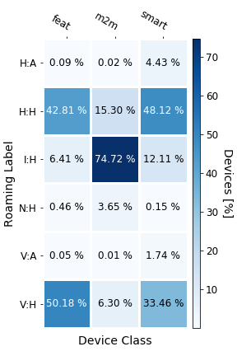
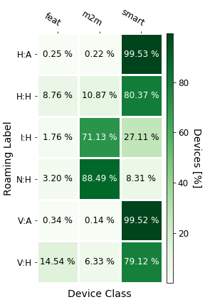
Inbound Roamers: Things or People?
Device type is classified with the GSMA TAC database and the APN
  GSMA DB: device manufacturer and operating systems
Majority of IoT devices are inbound roamers!
Out of all inbound roamers, only 27% are people!
Notes:
Now, the first question we asked was: “What are these devices? Things or people?”
So we created a way to classify the devices using the GSMA TAC database and the APN information.
We labeled devices in three classes, namely m2m (the IoT devices), smartphones and feature phone (which are simple phone terminals used mainly by people, but with less functionalities than smartphones).
We show that 75% of all the IoT devices in the network are inbound roamers.
Also, out of all the inbound roamers, only 27% are people!

Slide 9
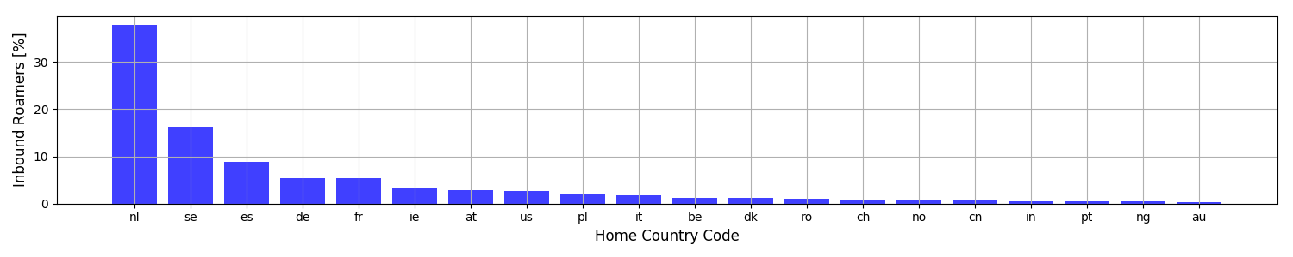
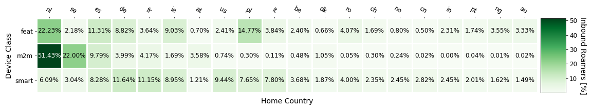
Where are devices roaming from in a MNO?
IoT devices

Slide 10
Many THINGS are roaming
Why they roam?
  IoT services need a global connectivity
International Carriers leverage their extensive infrastructure and deploy M2M platforms to support IoT verticals
  Carriers: Telefónica, Orange, Syniverse, Tata Communications …
  IoT verticals: smart meters, connected cars, health …
Notes:
Roaming is a major component for the success of M2M platforms
SIM for Things
Single home MNO supports connected things globally

Slide 11
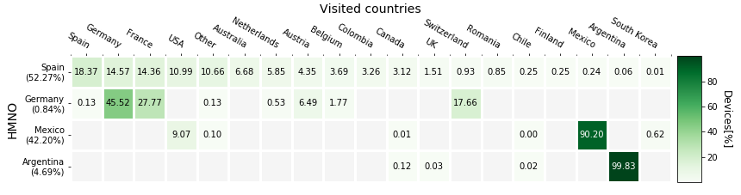
Breadth of an M2M platform
A view from one of the largest M2M platforms in the world enabling 4G/LTE devices world-wide
  77 countries and 127 VMNOs

Slide 12
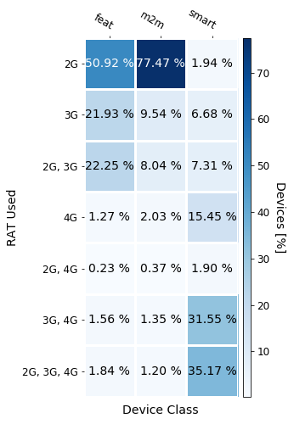
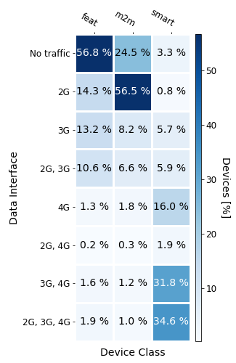
IoT devices – depend mostly on 2G connectivity

Slide 13
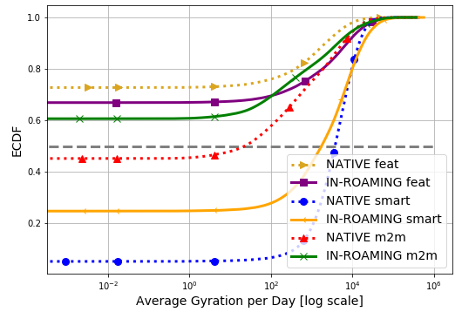
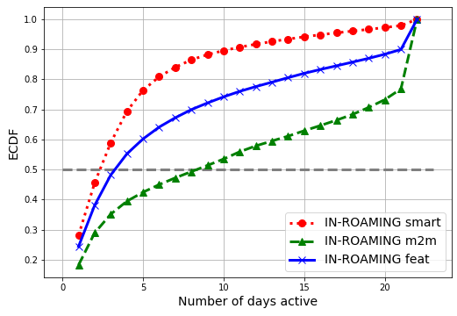
IoT devices – Less active but longer lived
Not moving as much
But active for longer times
On average, 4x longer

Slide 14
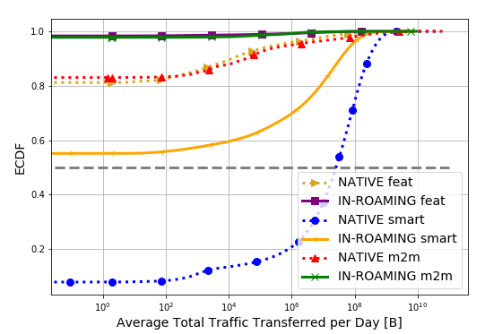
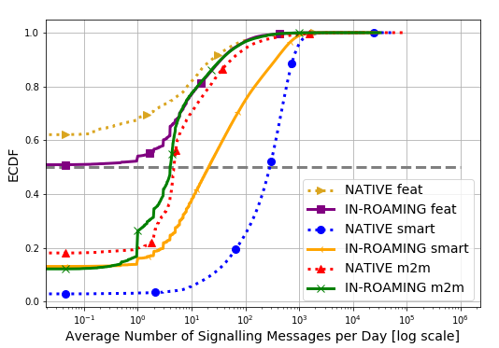
IoT devices – Less traffic but much more signaling
IoT consumes little data
But a lot of signaling
VMNO does not profit from billing data communications

Slide 15
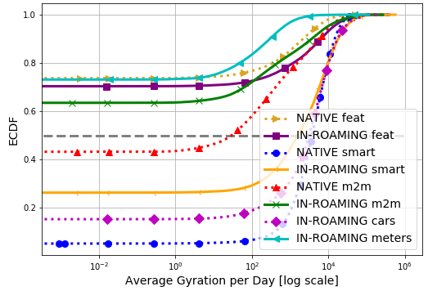
Moving cars and stay-at-home smart meters
Smart meters and connected cars

Slide 16
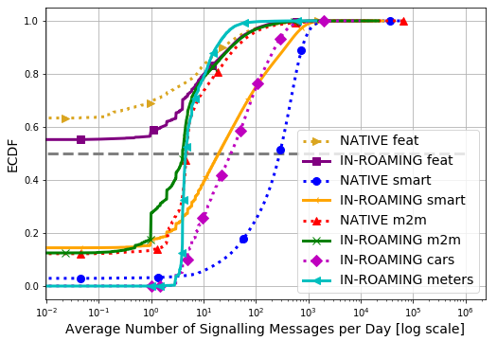
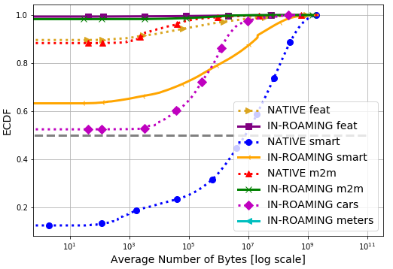
Moving cars – similar to smartphones
Connected cars are similar to roaming smartphones
And transfer large amounts of data

Slide 17
Conclusion
First characterization of roaming support for M2M communication
  IoT traffic patterns greatly differ from those of smartphones
IoT devices increase stresses on a visited MNO’s infrastructure
  Occupy radio resources
  Do NOT generate traffic that translates into revenue
Identifying IoT devices help manage the network
  We propose an approach for classifying devices into M2M, smartphones and feature phones

Slide 18
Backup slides

Slide 19

The Roaming interconnection ecosystem
Mobile Network Operator 3
Fixed Network Operators
Internet Service Providers
Interconnection Network
Mobile Network Operator 1
IPX Provider 1
Mobile Network Operator 2
IPX Provider 2
Enterprise and Financial Services
Content Provider
Application Service Providers
Notes:
Overall ecosystem

Slide 20

Configurations for Roaming
Mobile
Device
Evolved Universal
Terrestrial Radio
Access Network
Other MNOs, FNOs, ISPs, ASPs
eNodeB
eNodeB
MME
S-GW
R
R
S-GW
MME
HSS
HSS
Evolved Packet
Core (EPC)
AAA
AAA
P-GW
R
R
P-GW
HMNO
IPX Network
VMNO
Internet
IPX breakout
Local breakout
Home-routed
(1) Home-routed (2) Local breakout (3) IPX breakout
Notes:
Home routed roaming is the usual configuration

Slide 21
High level MNO architecture

Slide 22
Roaming between operators
Operators contract with IPX providers
  IPX provider provides the roaming hub function
Operators/roaming partners don’t need bilateral contracts
  Instead pay a service charge to the roaming hub
Inter-operator tariff (IOT) between the Home MNO(HMNO) and Visited MNO (VMNO)
Inter-operator tariff
Service Charge
Service Charge
HMNO
VMNO
IPX
Provider
IPX
Provider
Roaming hub
Roaming hub
Inbound roamers
Outbound roamers

