Slide 1
The Internet Impact Assessment Toolkit (IIAT)
The Internet Way of Networking Project
Promoting and defending critical properties of the healthy Internet

Slide 2
The need for environmental impact assessment… but for the Internet

Slide 3
“The Internet is a network of networks”
… So what?

Slide 4
The Internet Way of Networking (IWN)
We know that the Internet is incredibly successful. The question is: “why?”
What are the critical elements/properties of the Internet that led to its success and ensure its healthy evolution?
The Internet Way of Networking – what is it and why it matters
The Internet owes its success not only to the technology, but to the unique way it operates and evolves. This is what we call the Internet Way of Networking (IWN). It is how independent networks connect to one another, interoperate and, all together, form the global Internet. When the IWN is under threat, so are the opportunities and benefit it offers. In a nutshell, the Internet cannot fulfil its full potential.

Slide 5
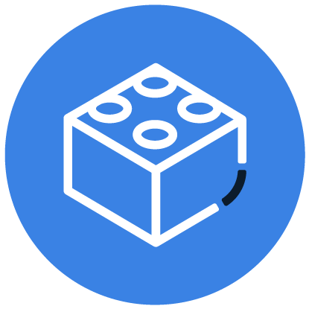
Five Critical Properties of IWN – The ideals to strive for
Accessible Infrastructure with a Common Protocol
Technology Neutral, General-Purpose Network
Open Architecture of Interoperable and Reusable Building Blocks
Decentralized Management and a Distributed Routing System
Common Global Identifiers

Slide 6
Five critical properties and their benefits
Critical Property | Benefits to the Users
An Accessible Infrastructure with a Common Protocol | Unrestricted access and common protocols deliver global connectivity and encourage the network to grow. As more and more participants connect, the value of the Internet increases for everyone.
A layered architecture of interoperable reusable building blocks | Open architecture creates common interoperable services, which deliver fast and permissionless innovation everywhere. The inclusive standardization process and demand-driven adoption ensures that useful changes are adopted, while unnecessary ones disappear.
Decentralized management and distributed routing | Distributed routing delivers a resilient and adaptable network of autonomous networks, allowing for local optimizations while maintaining worldwide connectivity.
A Common Global Identifier System | A common identifier set delivers consistent addressability and a coherent view of the entire network, without fragmentation or fractures.
A General Purpose Network | Generality delivers flexibility. The Internet continuously serves a diverse and constantly evolving community of users and applications. It does not require significant changes to support this dynamic environment.

Slide 7
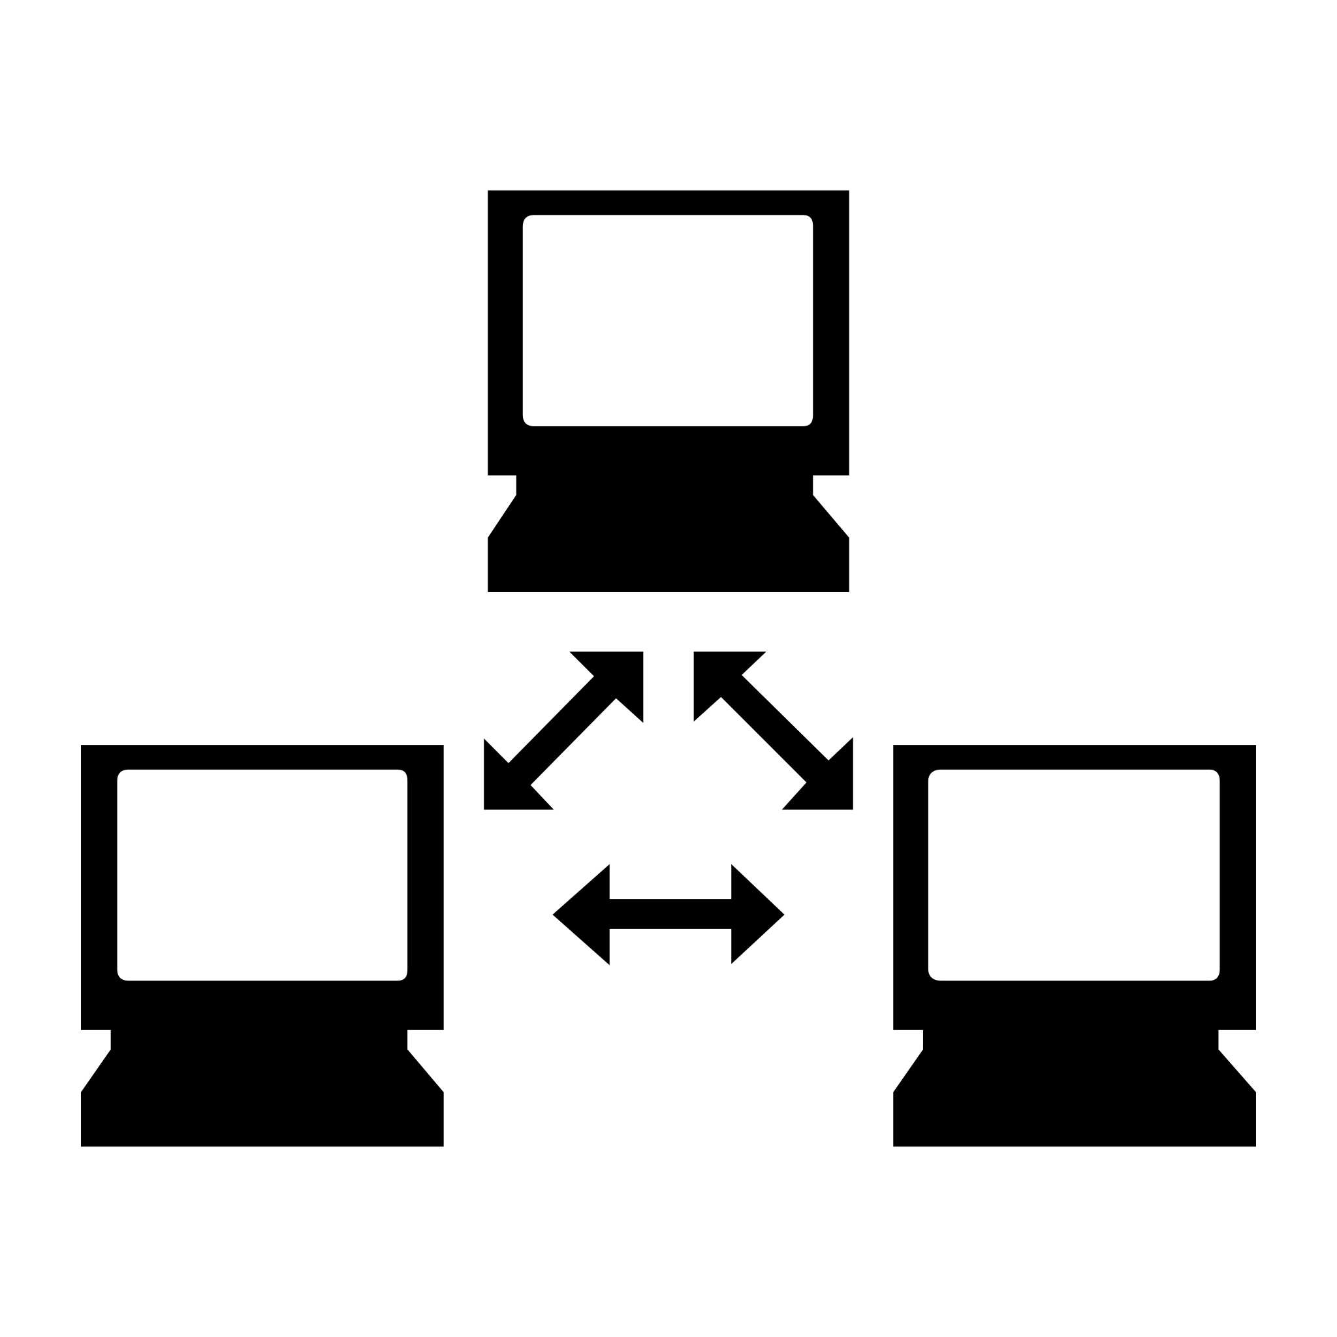
Network
Internet
Internet host
An open and accessible global infrastructure with a [CP1] common protocol and [CP4] common identifiers (addresses)
[CP2] Reusable common technology building blocks interoperable across layers and networks
[CP5] General purpose
[CP3]Networks define their own interconnection topology, and make their own decisions as to how to send their traffic (routing) across the network of networks

Slide 8
Network
Internet?
Internet host
An open and accessible global infrastructure with a common protocol and common identifiers
Reusable common technology building blocks interoperable across layers and networks
Specialized
General purpose
Networks define their own interconnection topology, and make their own decisions as to how to send their traffic (routing) across the network of networks

Slide 9
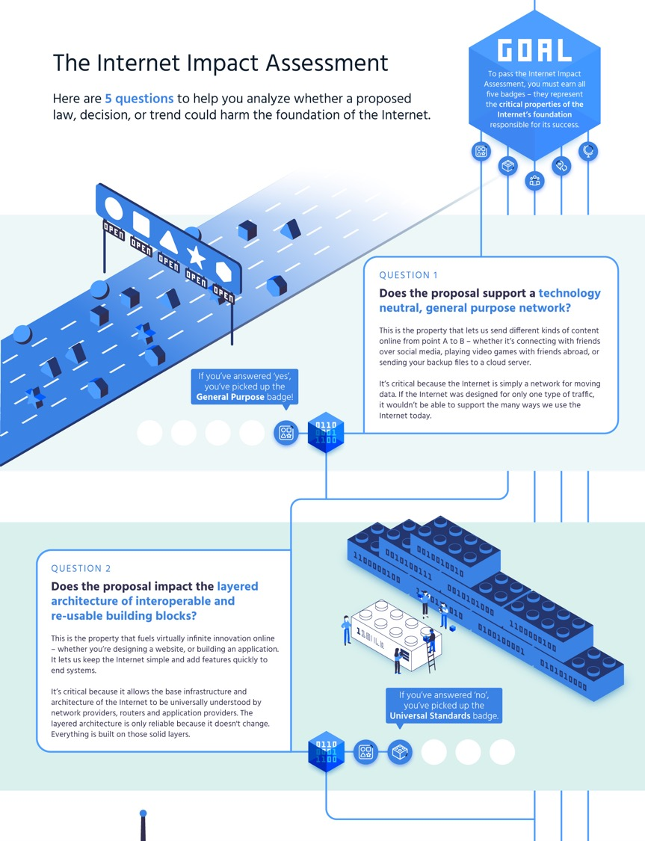
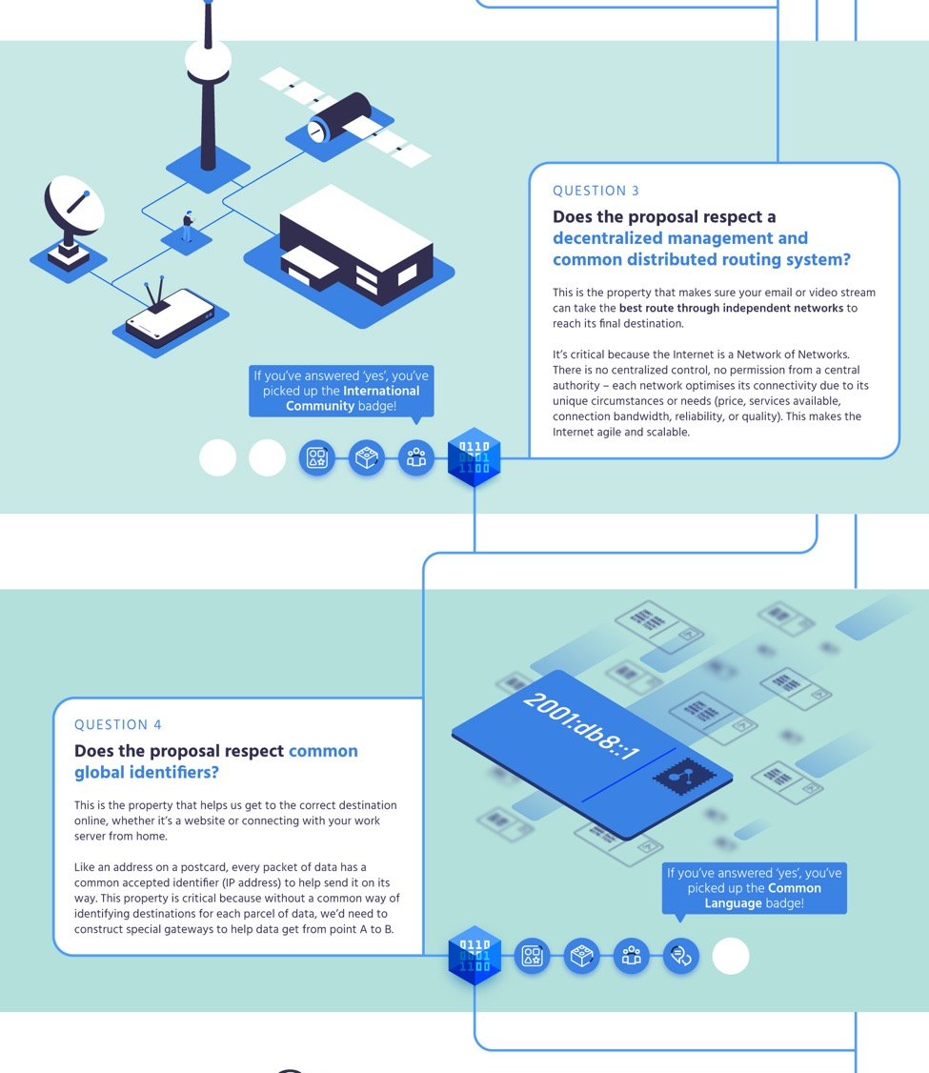

Slide 10
https://www.internetsociety.org/issues/internet-way-of-networking/internet-impact-assessment-toolkit/

